Slide 1




Development and Experimental validation of the Neutron Imaging Capability of the Dual Gamma-Neutron Vision (GN-VISION)
G. Cisterna${}^{1,2}$, J. Lerendegui-Marco${}^{2}$, J. Balibrea-Correa${}^{2}$, I. Ladarescu${}^{2}$, C. Domingo-Pardo${}^{2}$, B. Gameiro${}^{2}$, V. Babiano${}^{2}$, J. Hallam${}^{3}$
${}^{1}$ Universidad de Sevilla, Sevilla, España
${}^{2}$ Instituto de Física Corpuscular,, València, España
${}^{3}$ University of Surrey, Guildford GU2 7XH, UK
Erasmus Mundus
JMD on Nuclear Physics

Slide 2
Background for the development of GN-Vision

Slide 3
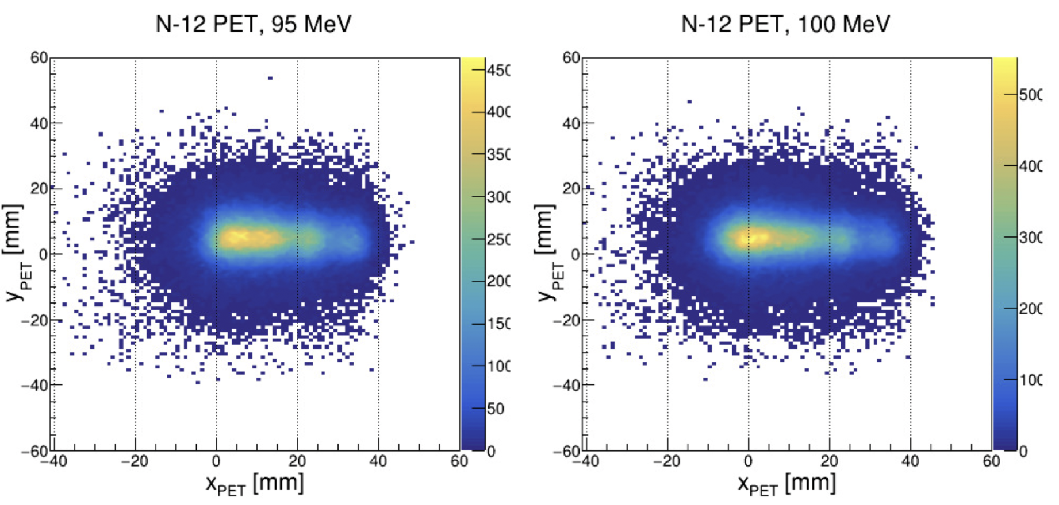
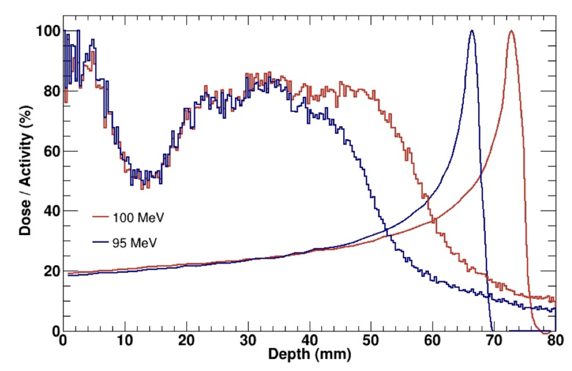

Background Motivations
Hadron Therapy
Particle therapy
Enhanced in-vivo range verification
Improved biological effectiveness of PT
Boron Neutron Capture Therapy (BNCT)
National Security and Nuclear Energy Industry
Characterizing spent-fuel from nuclear reactors for decommissioning
Homeland Security
* Simposio GEFN, XXXVIII Reunión Bienal de la RSEF, July 13th 2022, Murcia
“i-TED: Imaging neutron capture sections & applications”
*IAEA Incident and Trafficking Database (ITDB): 2022 Fact Sheet

Slide 4
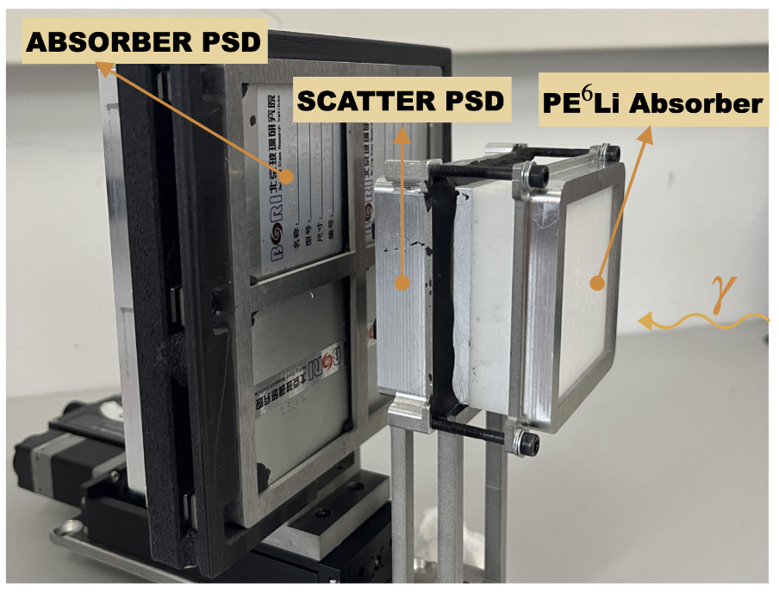
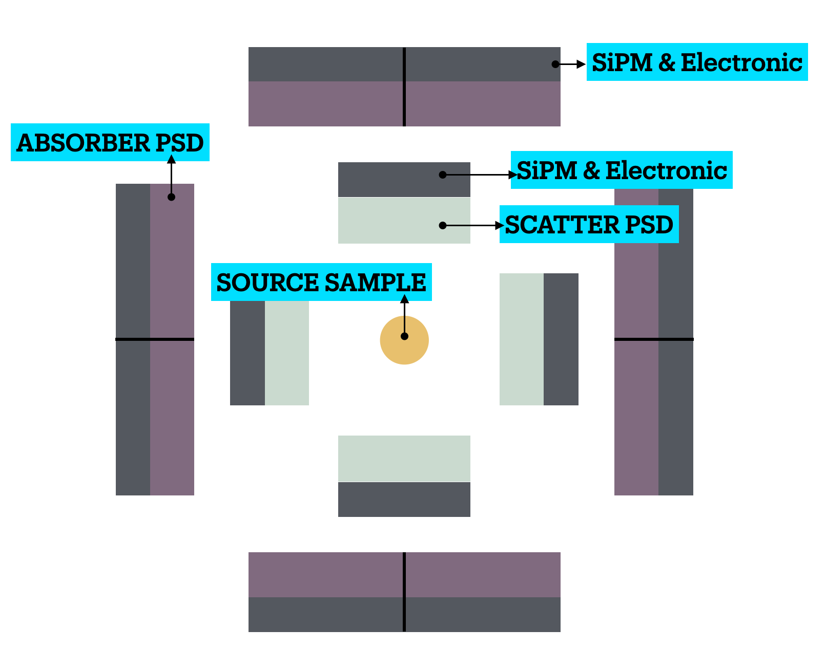

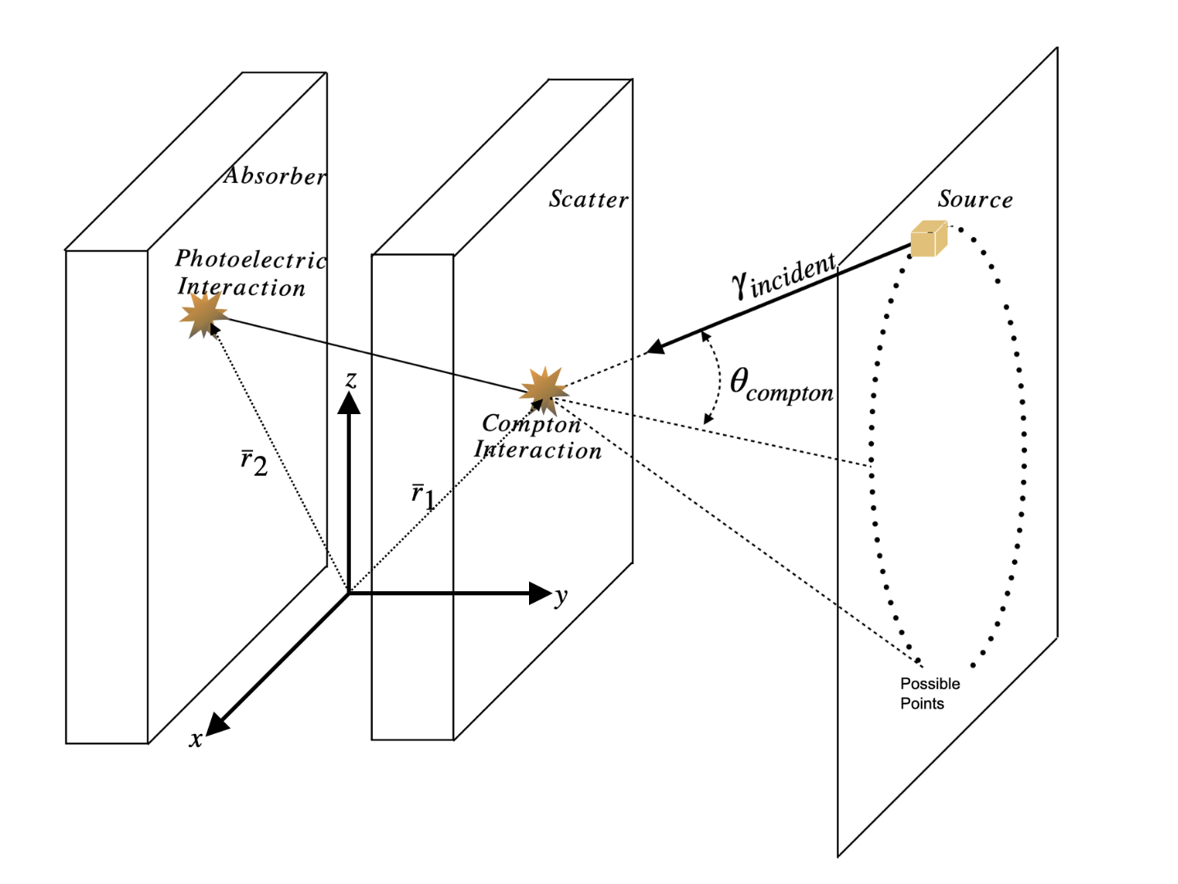
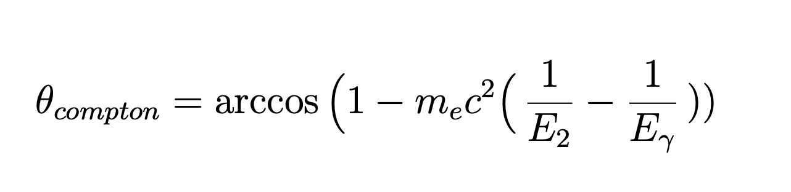
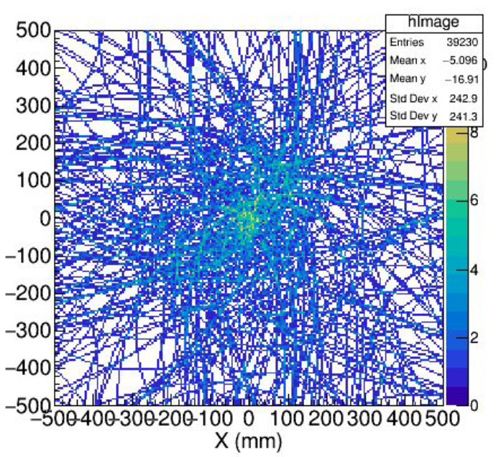
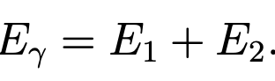
The i-TED Concept
State-of-the-Art and Motivation
Significantly improve the signal-to-background ratio in neutron capture measurement
Relevance for the stellar nucleosynthesis in key (n,γ) reactions
i-TED Design
Scatter PSD plane: 50x50x15mm LaCl${}_{3}$scintillation crystal
Absorber PSD plane: 4 50x50x25mm LaCl${}_{3}$ scintillation crystal
Each crystal: 8x8 SiPM (6% @ 662 keV and 1-3 mm spatial resolution )
The full i-TED 1280 output signals
Integrated SiPM readout system developed by PETsys Electronics: the front-end house ASICs and back-end with FPGA boards
Compton Imaging
Fast Back-Projection (BP)

Slide 5
GN-Vision: Imaging of -rays and Neutrons

Slide 6
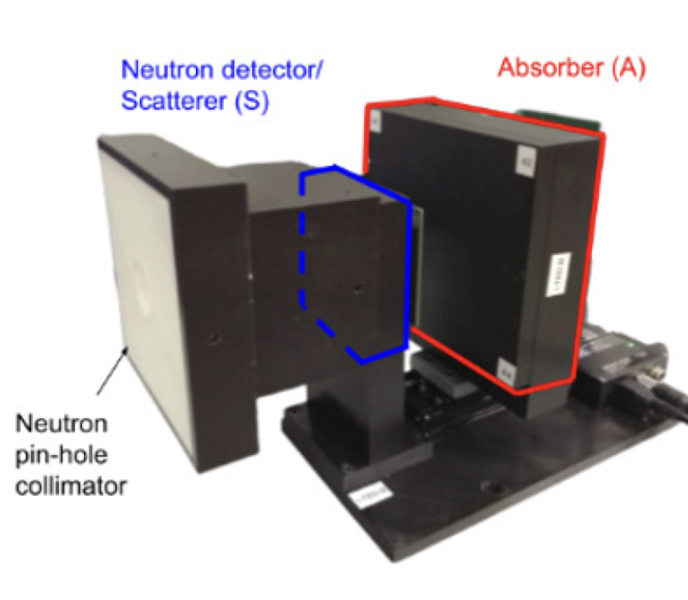
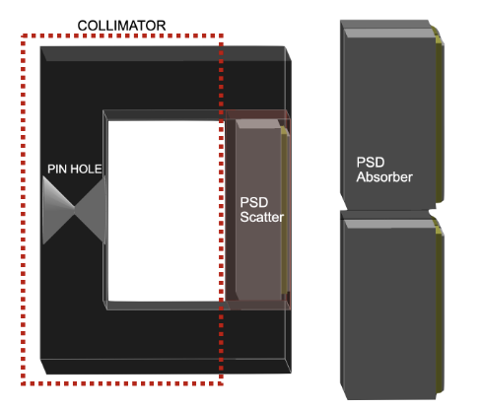
Overview & Core components of GN-Vision
Overview of GN-Vision
Built upon the technological foundation established by the i-TED system, incorporating significant enhancements :
Scatter PSD: By replacing the scatter crystal from LaCl${}_{3}$ to CLYC-6
Slow Neutron Imaging:passive pinhole collimator
Compton Imaging
Neutron Imaging
Pinhole Collimator
Collimator material is $PE^{6}Li$ due to its high absorbing power and simple mechanization.
${}^{6}Li$ does not emit $γ$-rays.
${}^{6}Li$ is 95% purity but natural $Li$ is under studied for cost reduction reasons
Neutron image is formed by scaling the interaction positions in the CLYC detector by the ratio between the LongFocal distance and ShortFocal distance
LongFocal
ShortFocal
*Jorge Lerendegui-Marco et al.: “Simultaneous Gamma-Neutron Vision device: a portable and versatile tool for nuclear inspections”

Slide 7
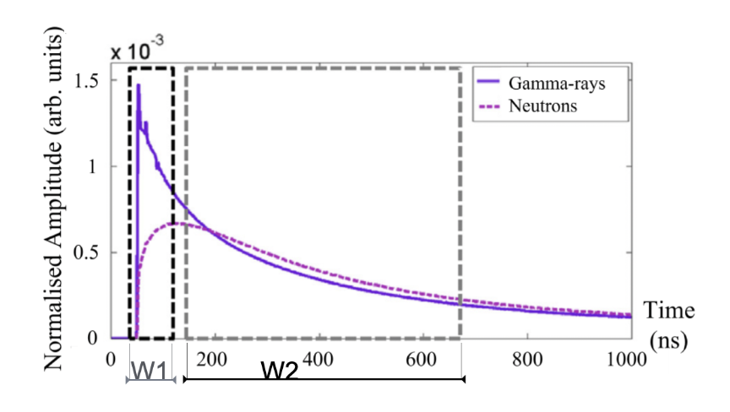
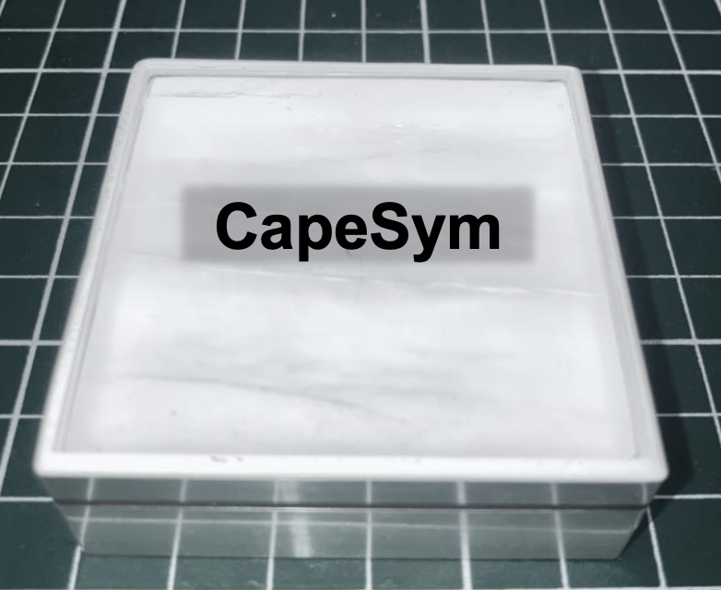
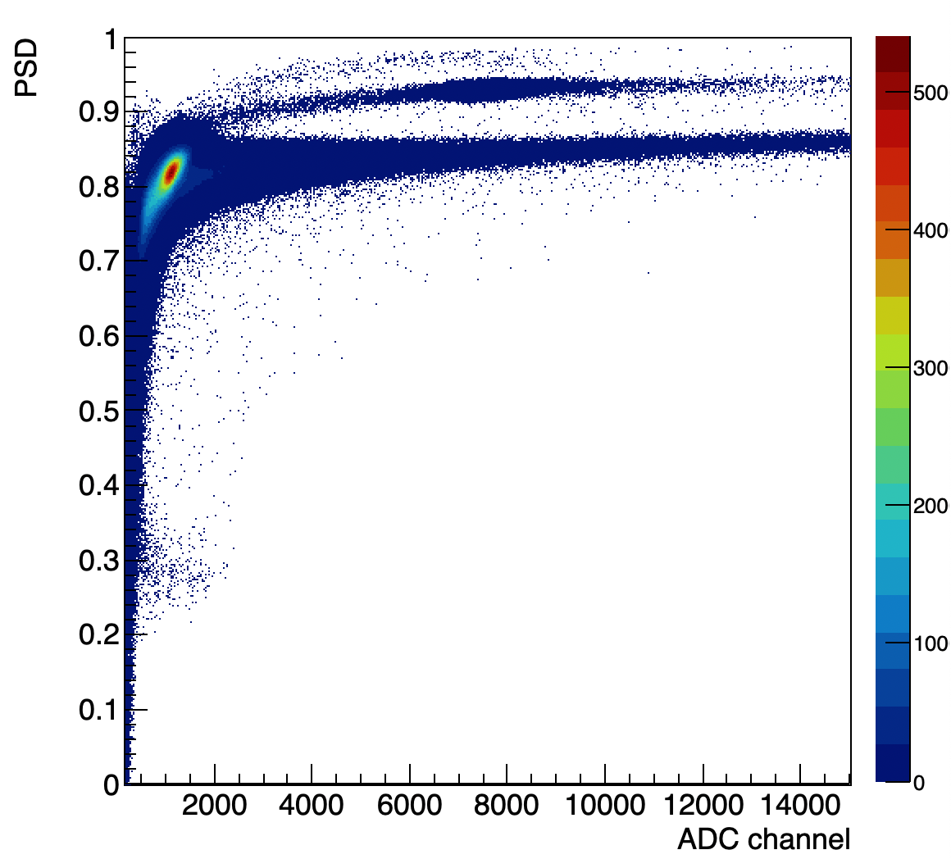
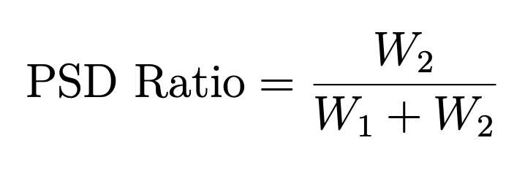
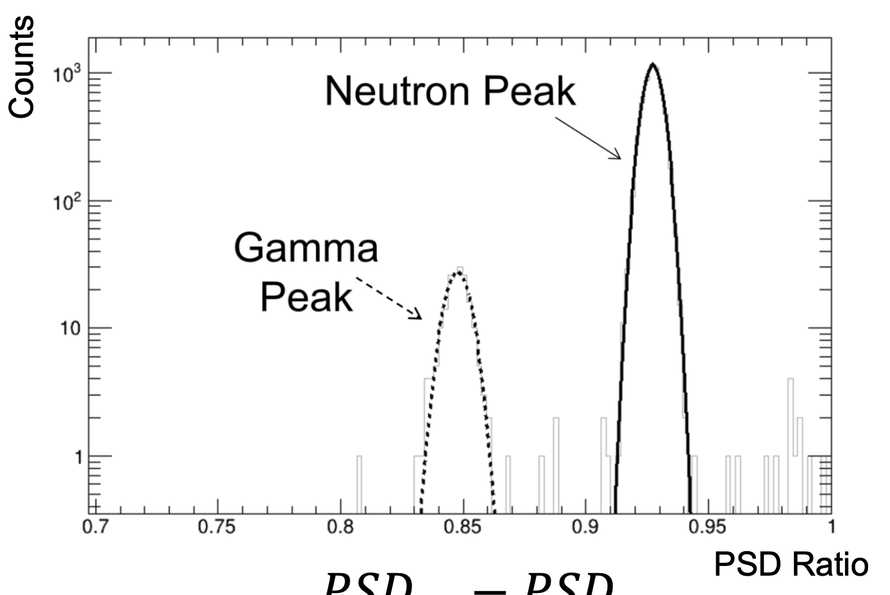
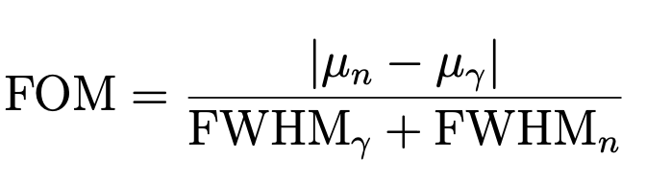
Overview & Core components of GN-Vision
CLYC crystal: $Cs_{2}LiYCl_{6}$
$Cs_{2}LiYCl_{6}$ (CLYC) monolithic crystals as Scatter PSD:
Thermal Neutrons: ${}^{6}Li(n_{th},α)^{3}H$ with a cross section of 940 b and $Q_{value}$= 4.78 MeV (3.2 MeVee)
To enhance fast neutron detection: ${}^{7}Li$ instead of ${}^{6}Li$.
Neutron-Gamma Discrimination via Pulse Shape Discrimination
Thermal Neutrons
$γ$-rays

Slide 8
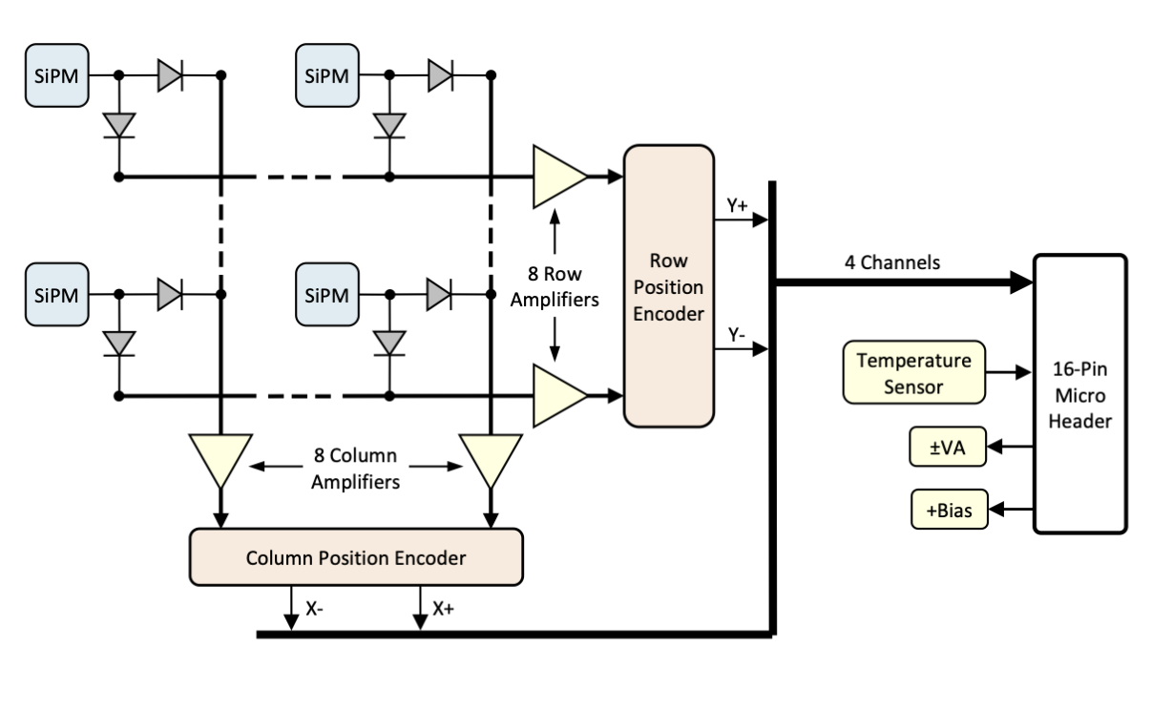
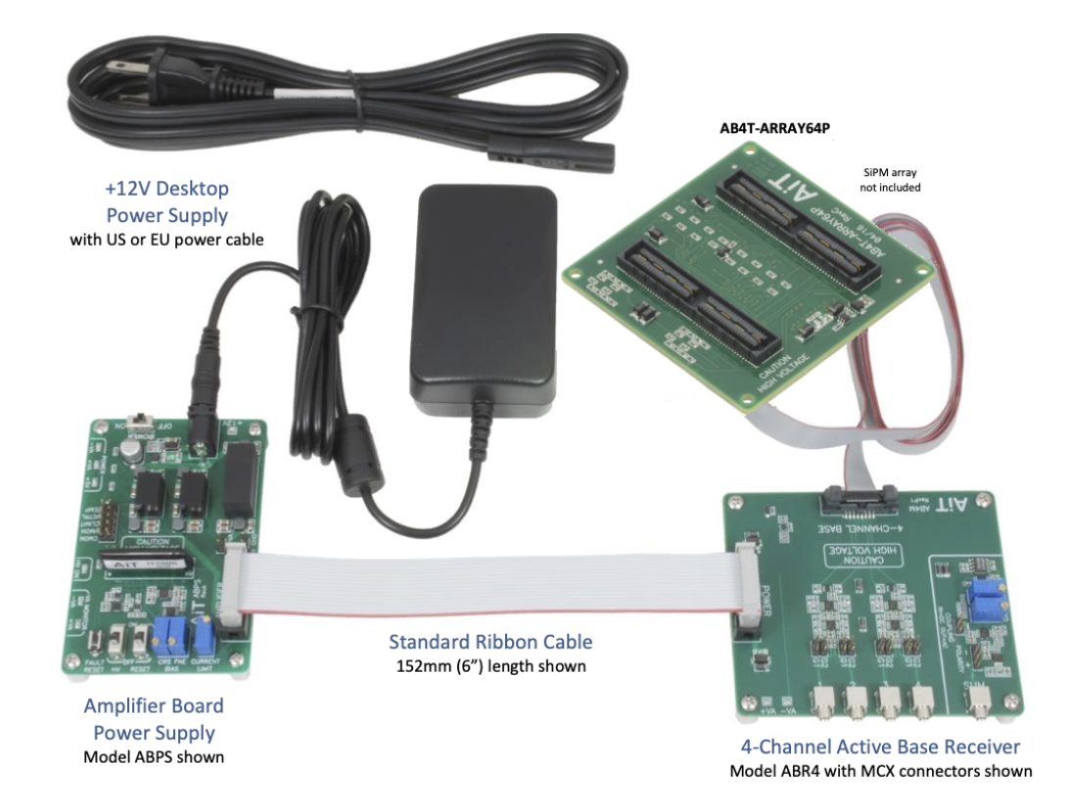
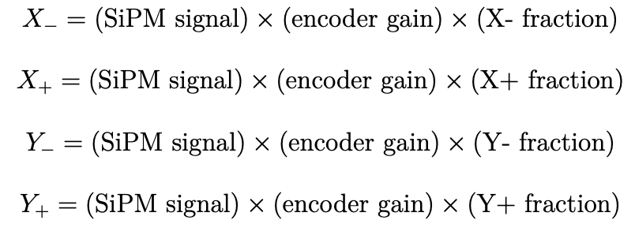
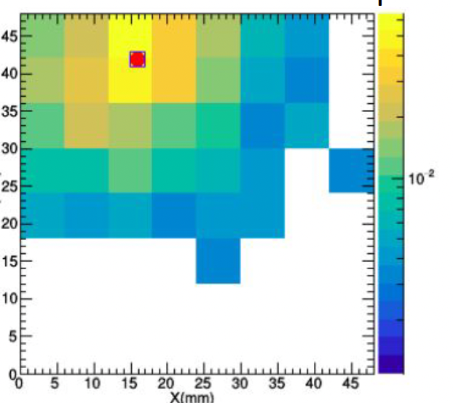
Readout electronics of GN-Vision
Challenges with Individual Read-Outs
Light yield CLYC is 20,000 photons per MeV much smaller than LaCl${}_{3}$ of 50,000 photons per MeV
Signal width of CLYC ($∼$4-5 µs) is greater and more diffuse than that of LaCl${}_{3}$ (300 ns)
i-TED
Light yield per ns and per MeV in CLYC is $∼$80 times smaller leading to SNR challenges when using CLYC with pixelated SiPMs
Charge Modulation-Based Multiplexing (CMBM)
$$X_{column}=\frac{(X_{+}-X_{-})}{(X_{+}+X_{-})}$$
$Y_{row}=\frac{(Y_{+}-Y_{-})}{(Y_{+}+Y_{-})}$

Slide 9
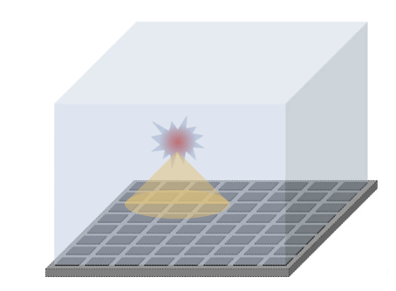

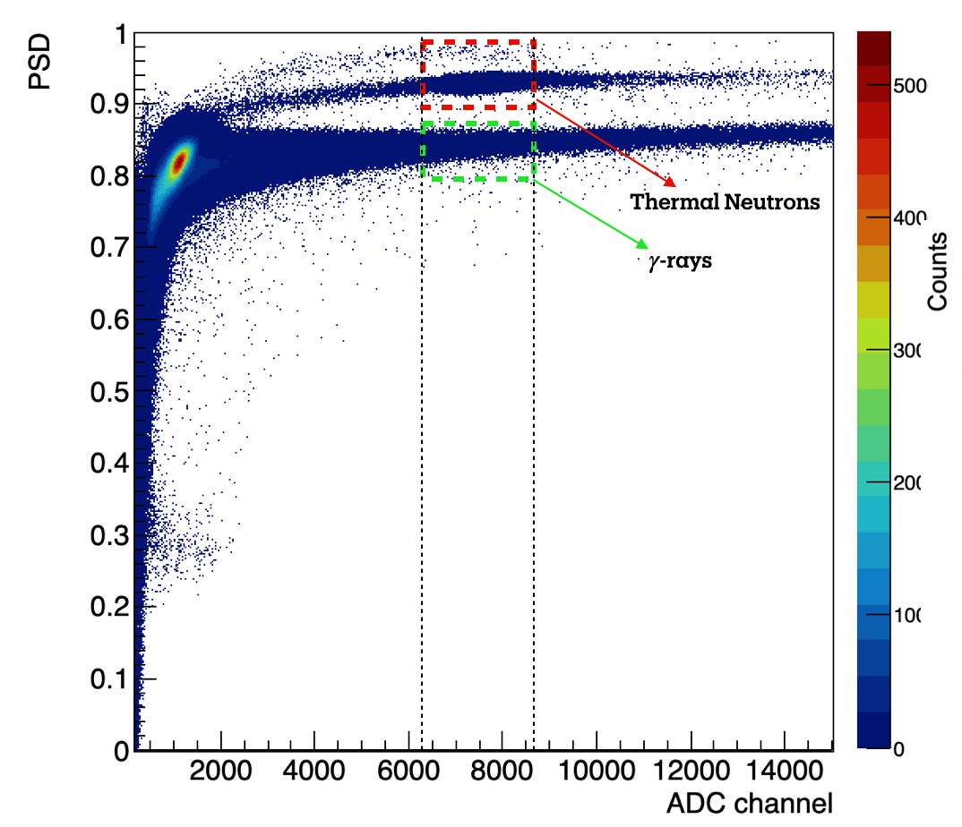
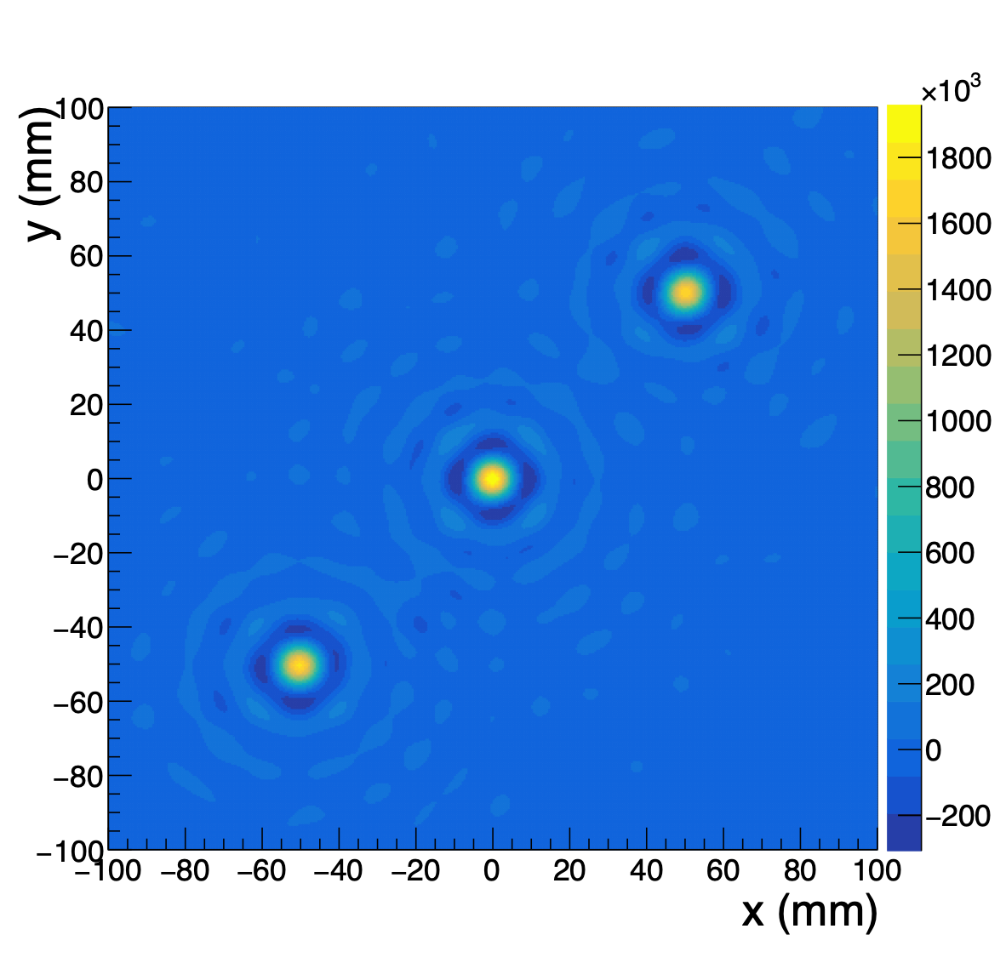
GN-Vision: status and goals of this work
V
Our objectives include:
Spatial Resolution Characterization
Spatial resolution of CLYC monolithic crystal using AiT's readout for $γ$-radiation.
Linearity Study
Linearity of the CLYC crystal of interaction points
Neutron Response and Discrimination
Initial tests of GN-Vision's response to neutron irradiation
Experimental Proof-of-Concept
Experimental proof-of-concept for neutron imaging capability at ILL, France
Monolithic crystal + SiPM array
=
Spatial Resolution depending
on pixels activated

Slide 10
Characterization of the spatial resolution of the CLYC

Slide 11
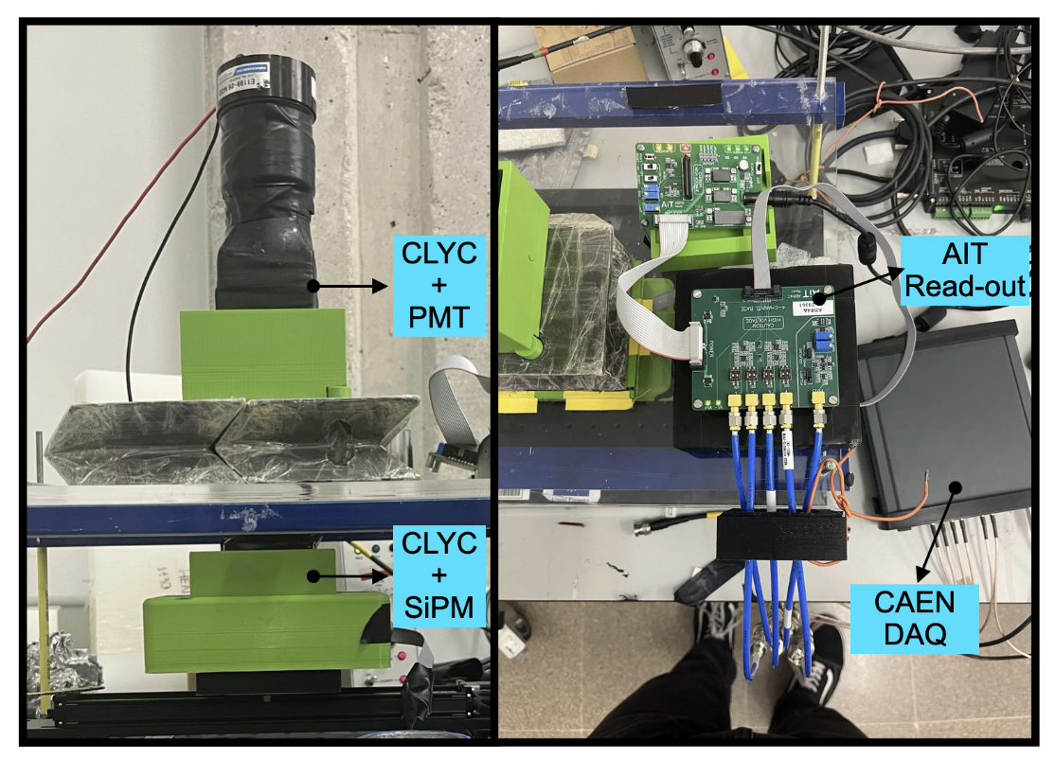
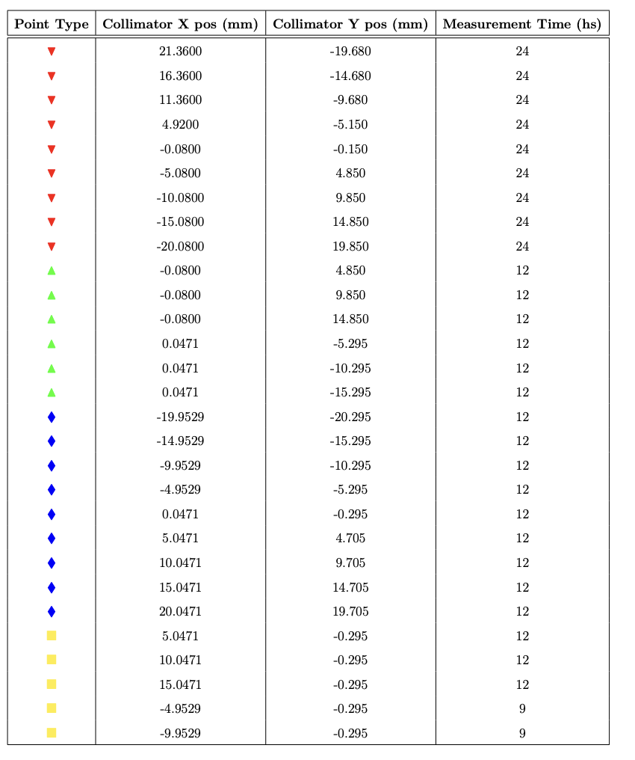
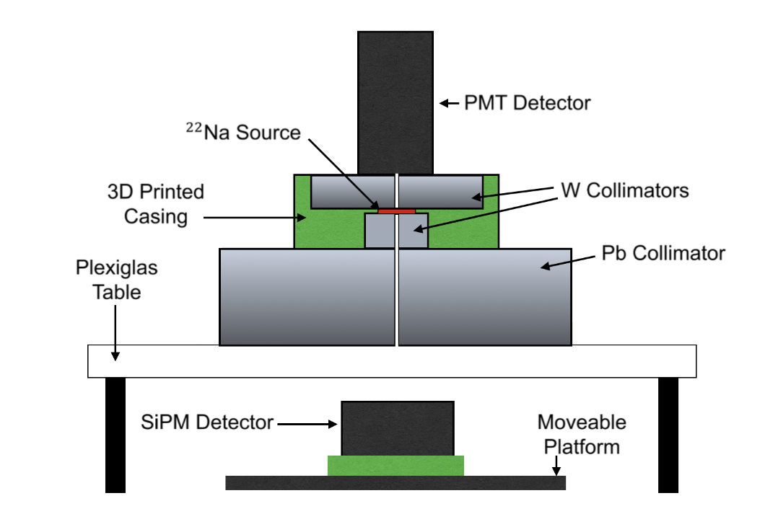
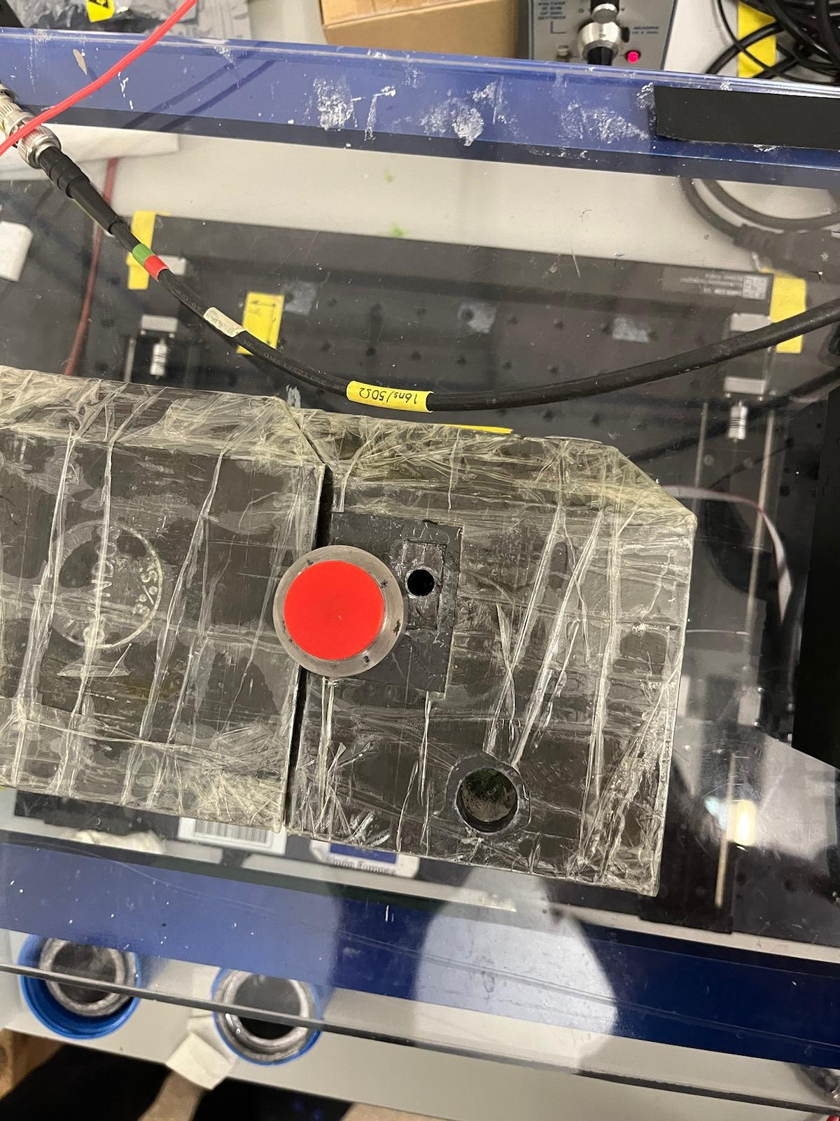
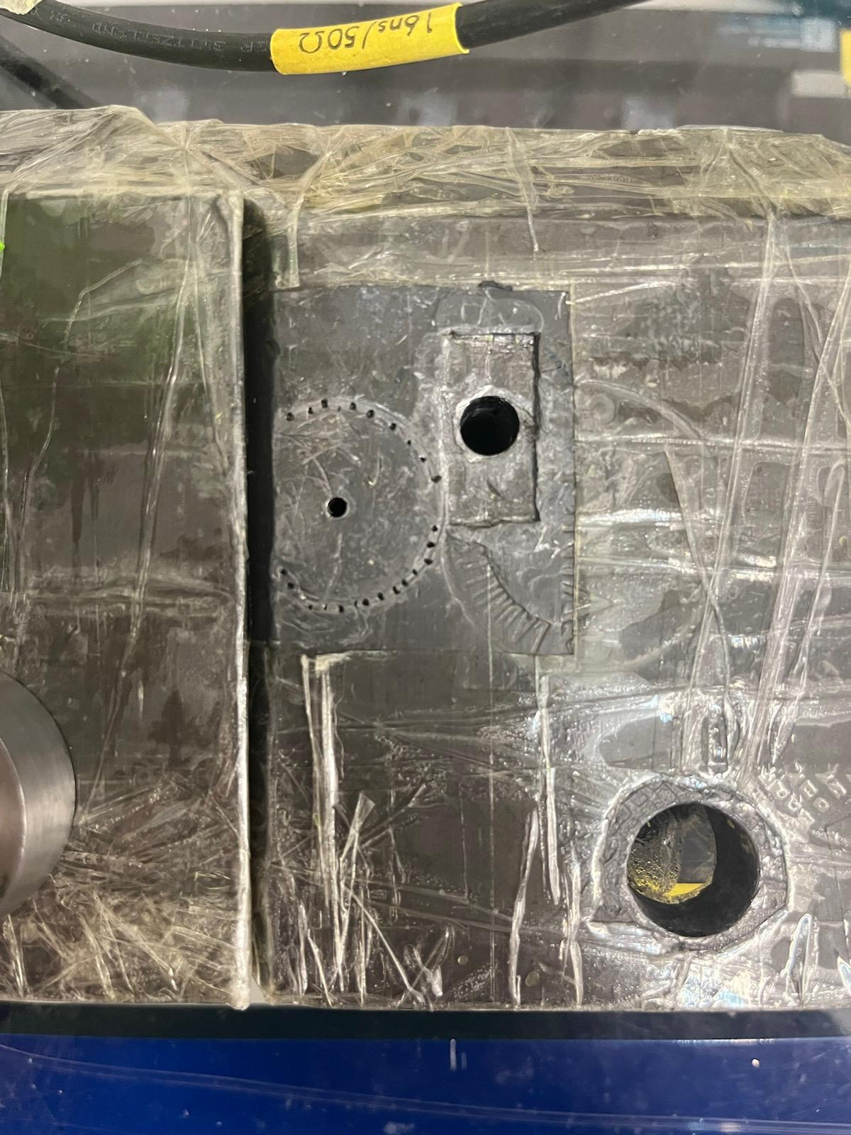
Experimental Setup and Measurements
Experimental Set up
2 CLYC scintillator crystal: One located at the top and one at the bottom of the setup.
8 × 8 silicon photomultiplier array (SiPM) from SensL (ArrayJ-60035-65P-PCB) couple to lower CLYC.
PMT :couple to upper CLYC
4-Channel Readout instrumentation from AiT: Readout electronic lower CLYC.
CAEN DT5730S DAQ motherboard: for data acquisition and processing of signals from the setup.
Movable platform (T-G-LSM200A200): Mechanical material with a microstep precision of 0.047625 μm, used to move the position-sensitive detector.
${}^{22}$Na source (2 MBq activity): a gamma-ray source in the setup.
Collimators: Tungsten parallelepiped collimator, circular tungsten collimator and Lead collimator. Distance between the front faces of both CLYC crystals is 26 cm. Provide Mechanical collimation.
22Na Source
Collimator hole
Z
Positioning holes
X

Slide 12
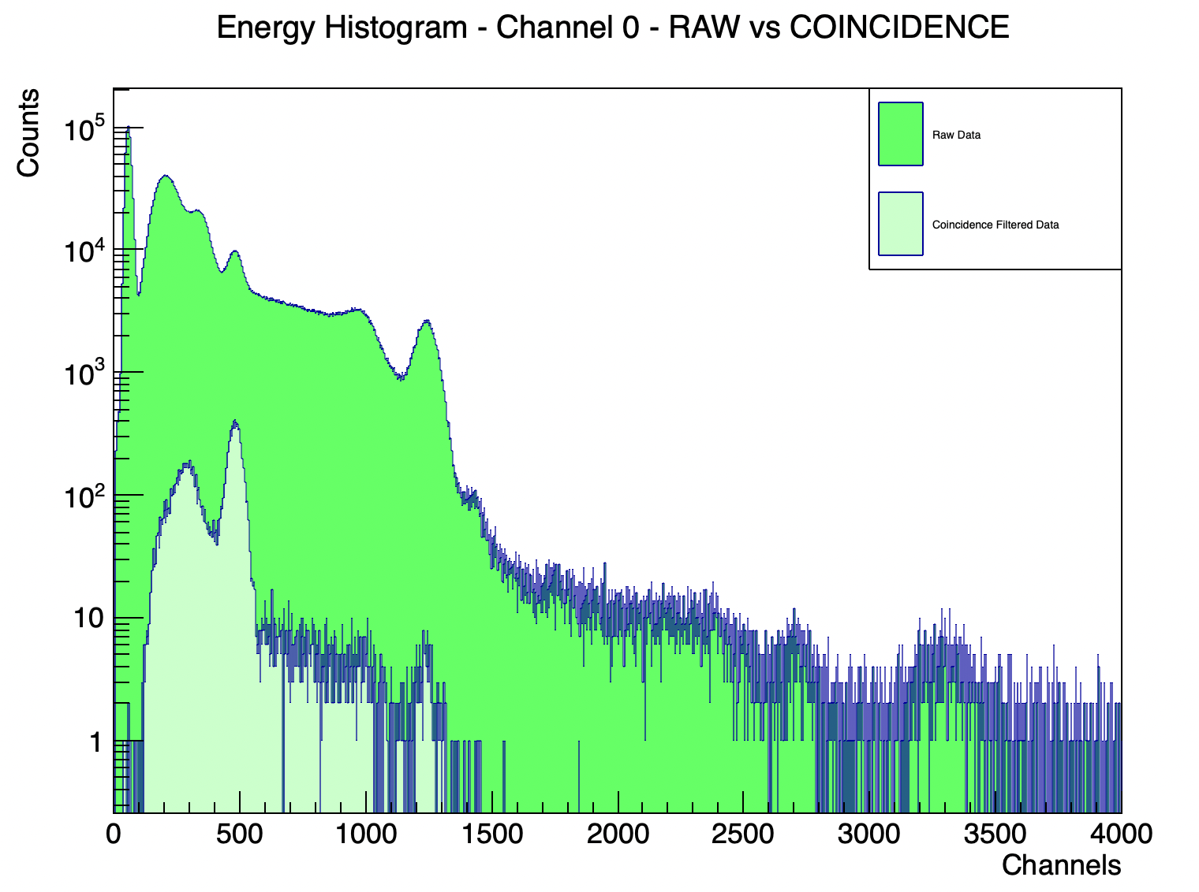
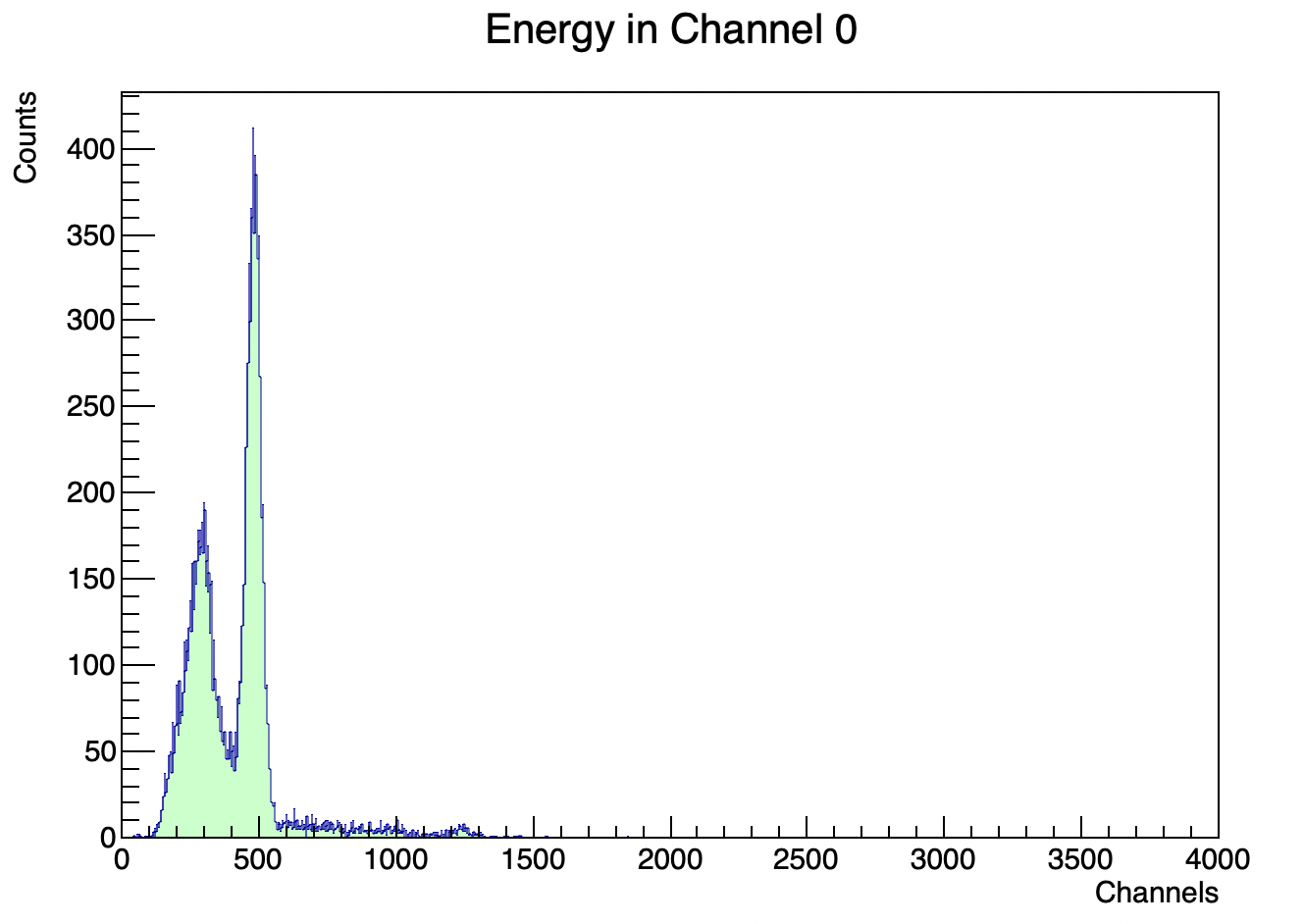
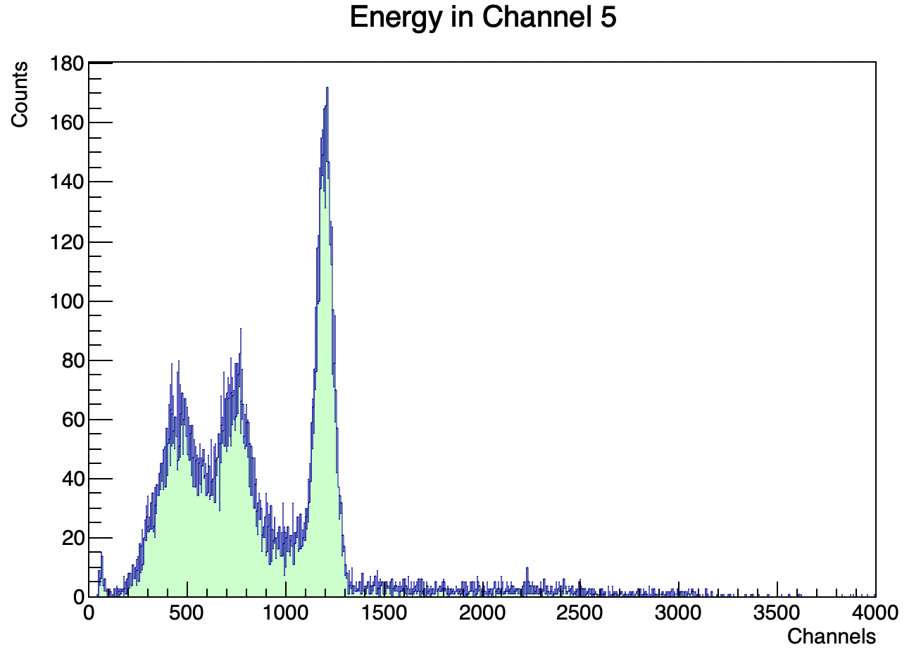

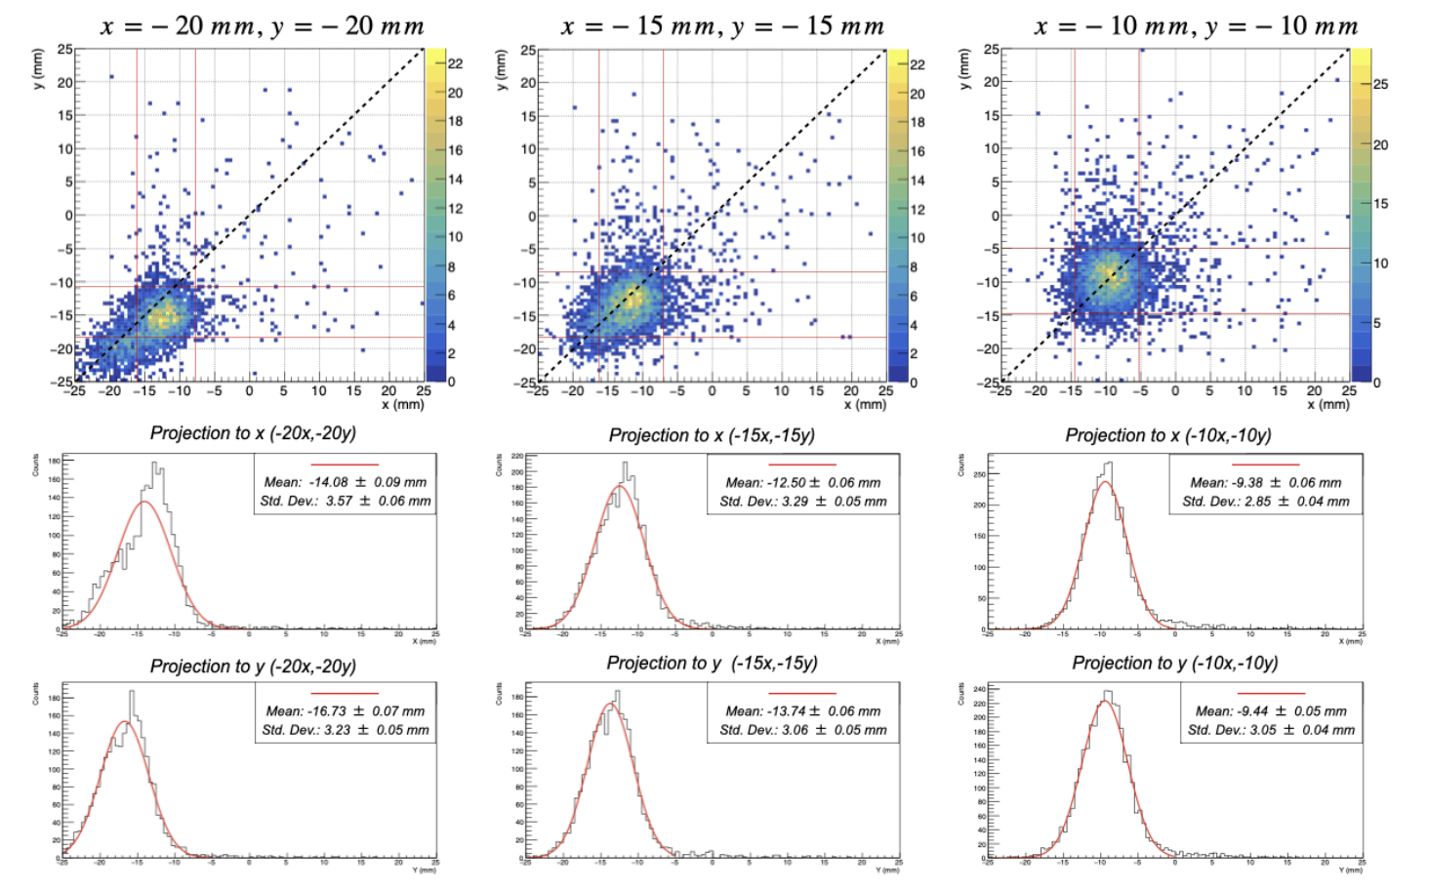
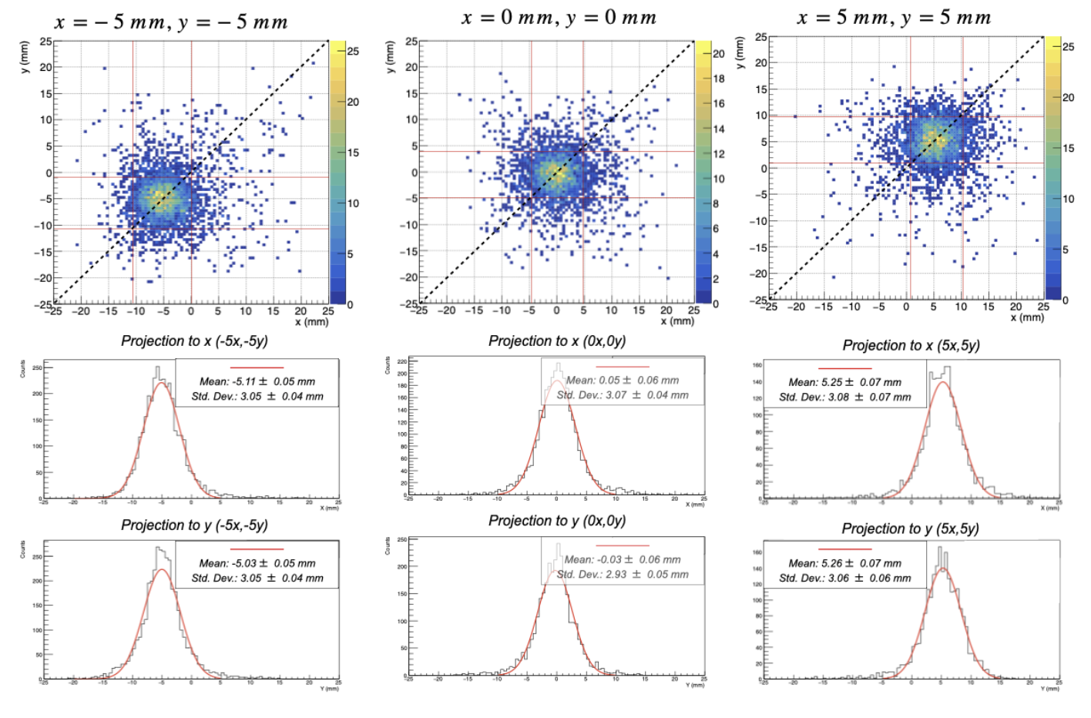
Gamma-Ray Event Selection & Interaction Position Reconstruction
Coincident and fully absorbed events
Ch 0: CLYC + SiPM
Ch 0: CLYC + SiPM
Ch 5: CLYC + PMT
Interaction position reconstruction

Slide 13
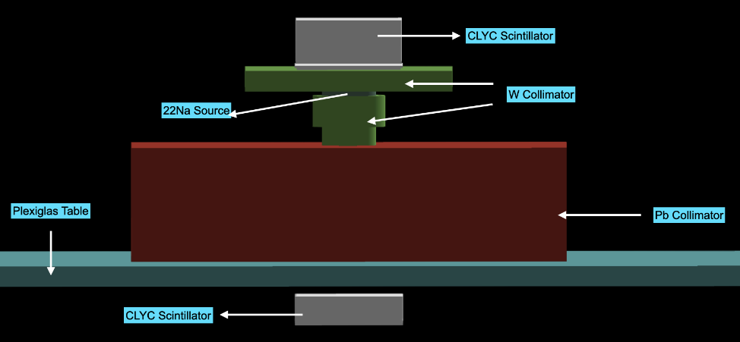
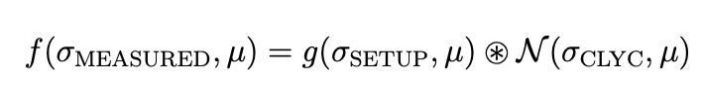
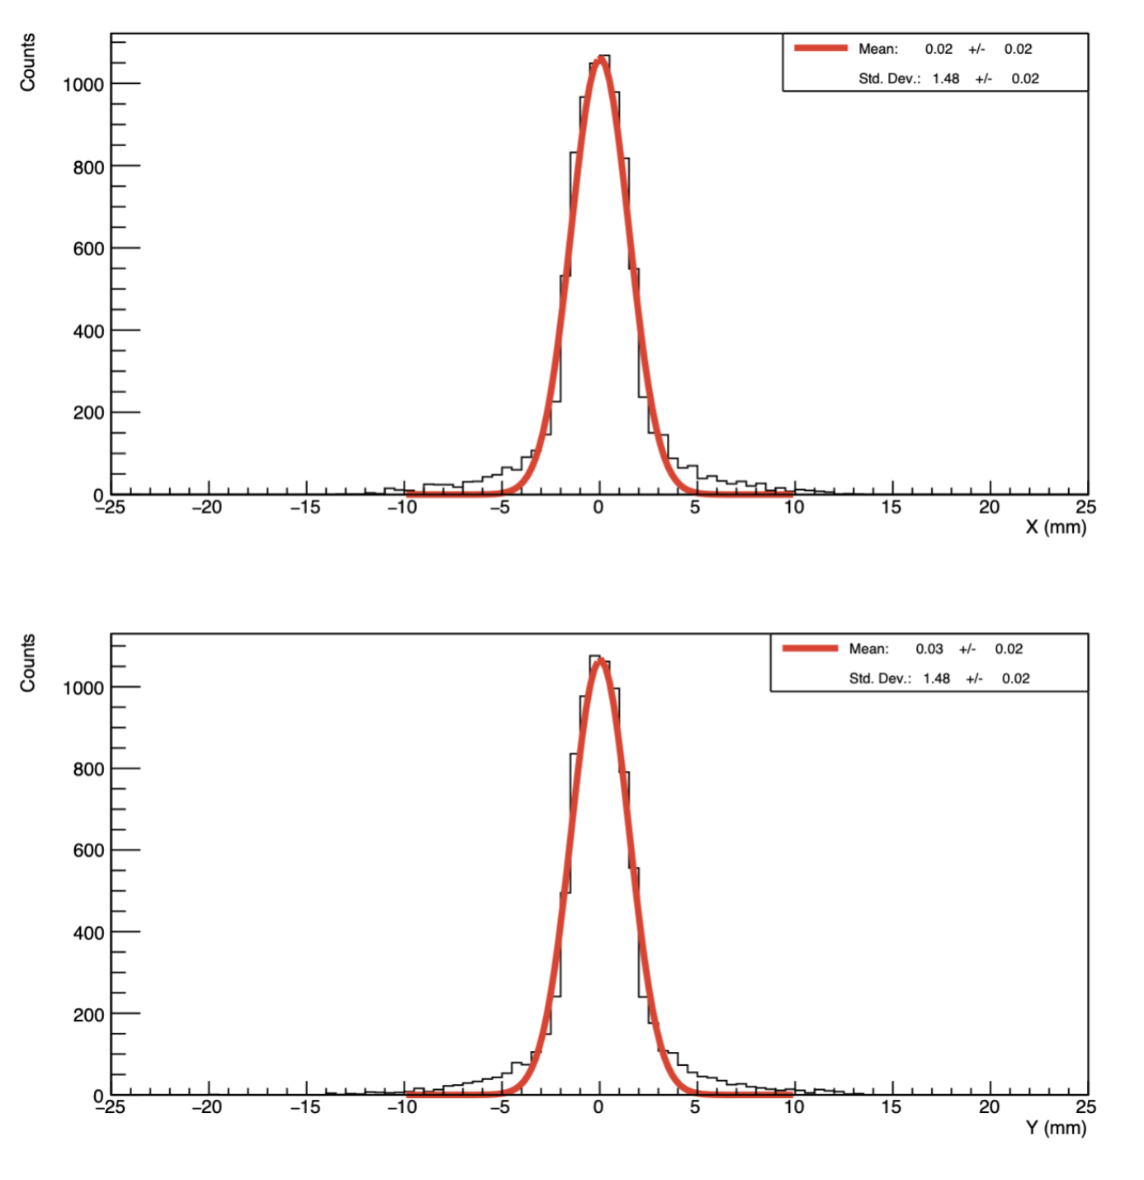
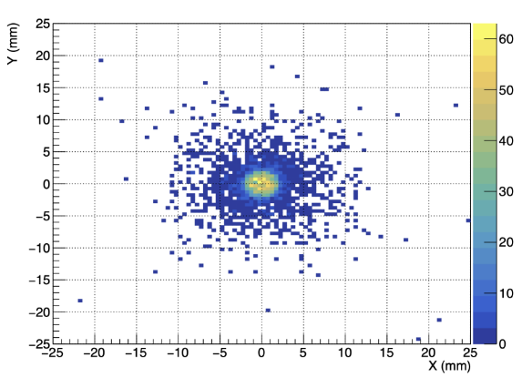
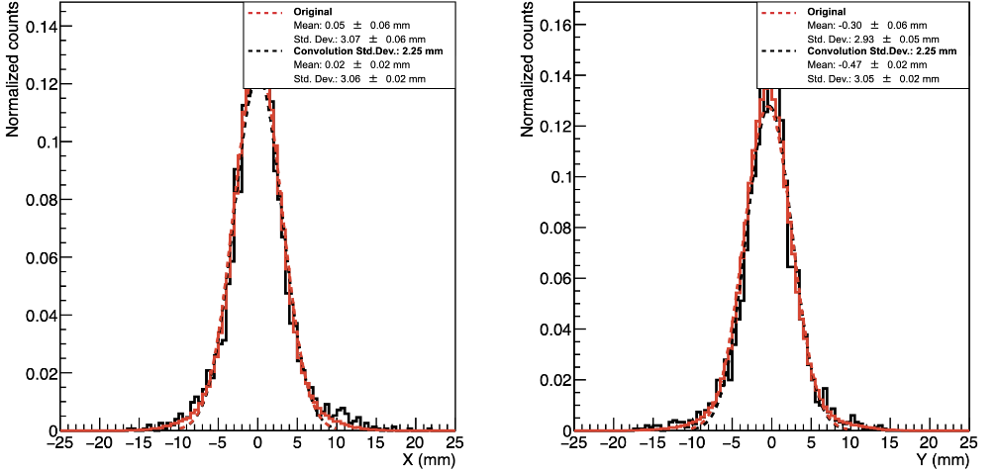
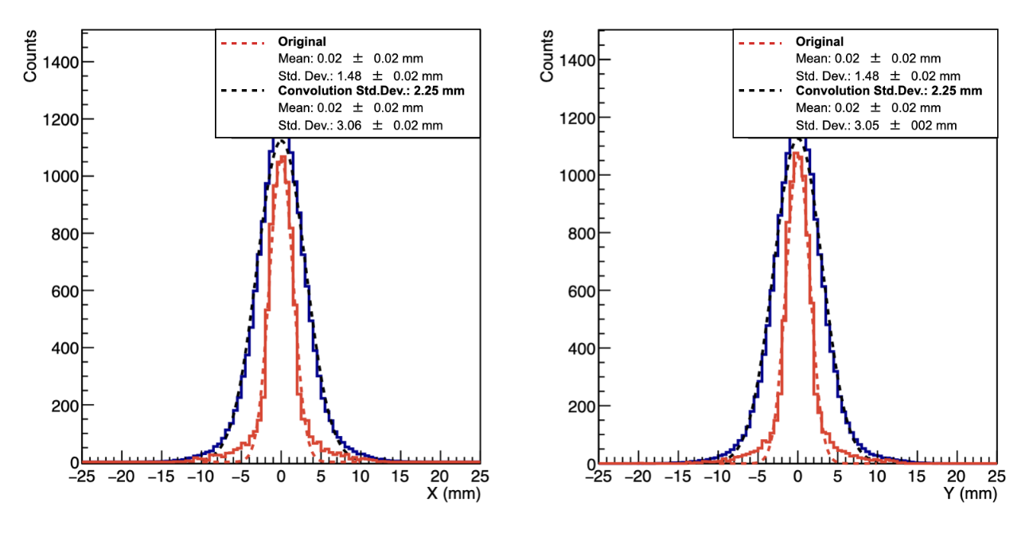
Geant4 simulations
Center the collimator hole with the
center of the CLYC crystal: (0x,0y)
—————
Mean: 0.02 $±$ 0.02 mm
Std. Dev.: 1.48 $±$ 0.02 mm
—————
Mean: 0.02 $±$ 0.02 mm
Std. Dev.: 1.48 $±$ 0.02 mm
Comparison of the measured projections with the convoluted projections
Projections of the Geant4 simulation convoluted with a Gaussian distribution with std. dev. 2.25 mm
FWHM (x=0,y=0)= 5.18 mm

Slide 14
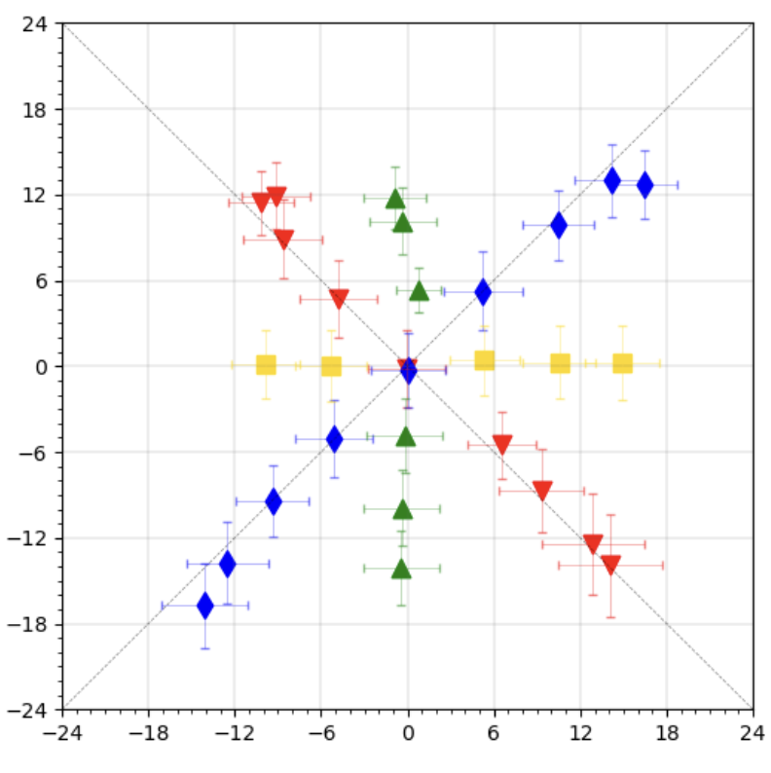
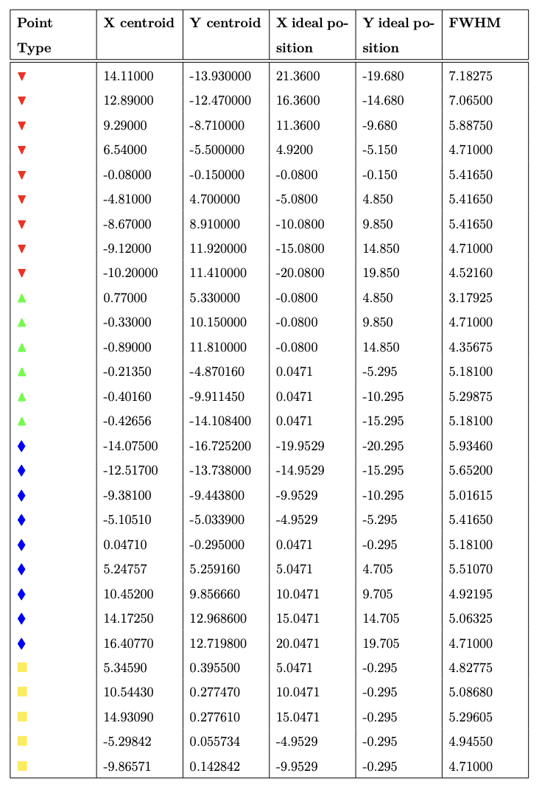
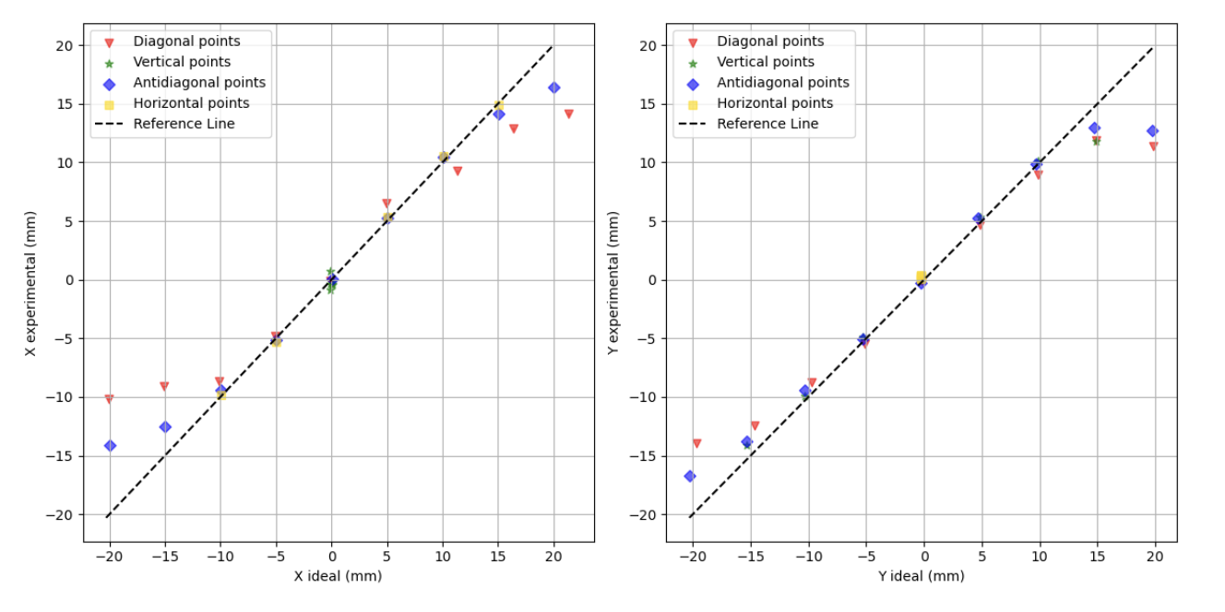
Results
Results
FWHM obtained in these measurements is generally below 6 mm (< pixel size ). Indeed, several points have FWHM values below 5 mm.
Beyond 15 mm, the compression effect becomes more significant, and almost no positions are reconstructed in this area. Need to apply an analytical or Machine-Learning based correction

Slide 15
First test of the position-sensitive’s response to neutrons

Slide 16
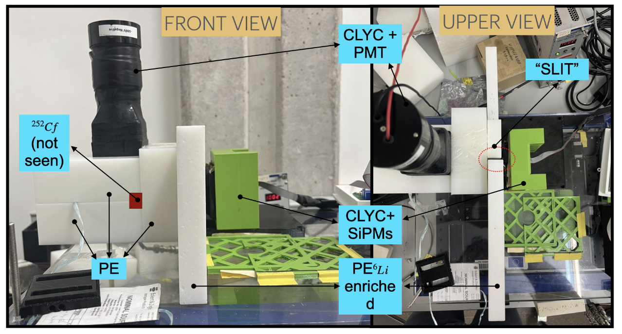
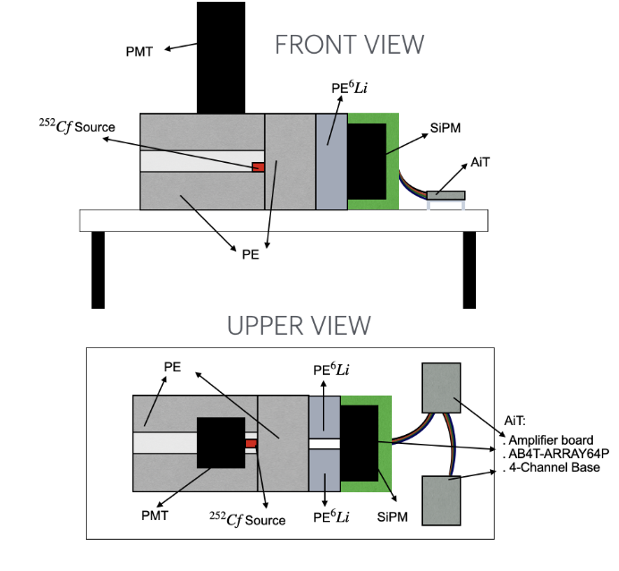
Experimental setup & Measurements
Experimental setup:
${}^{252}$Cf source: Neutron and $γ$-ray source through alpha decay and spontaneous fission
Polyethylene (PE): Collimator with a slit for thermal neutrons to reach the CLYC detector.
PE enriched with 95% of ${}^{6}Li$ slab: Collimator with a slit for thermal neutrons to reach the CLYC detector.
CLYC crystal, AiT readout electronics and Caen DACQ Motherboard: The same CLYC and electronics readout utilized in the spatial resolution $γ$ setup.
Duplication of Signal: Sum channel provided by AiT readout, duplicated for energy resolution and neutron-gamma discrimination.

Slide 17
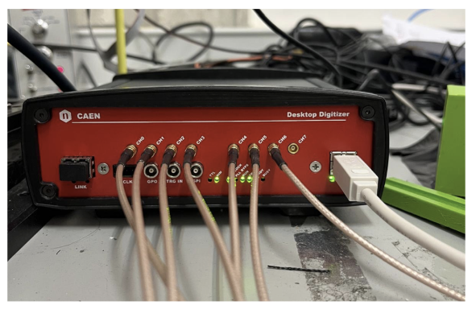
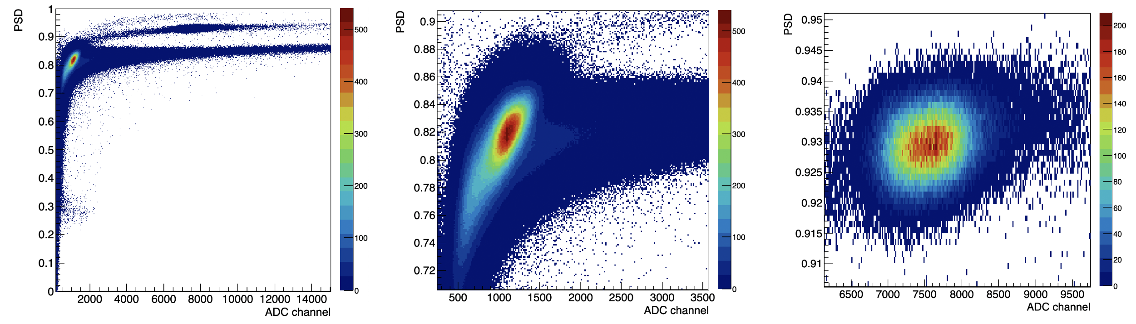
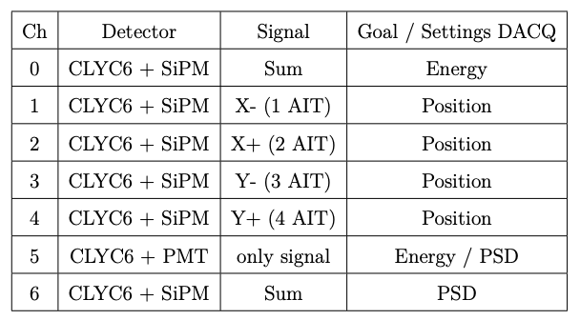
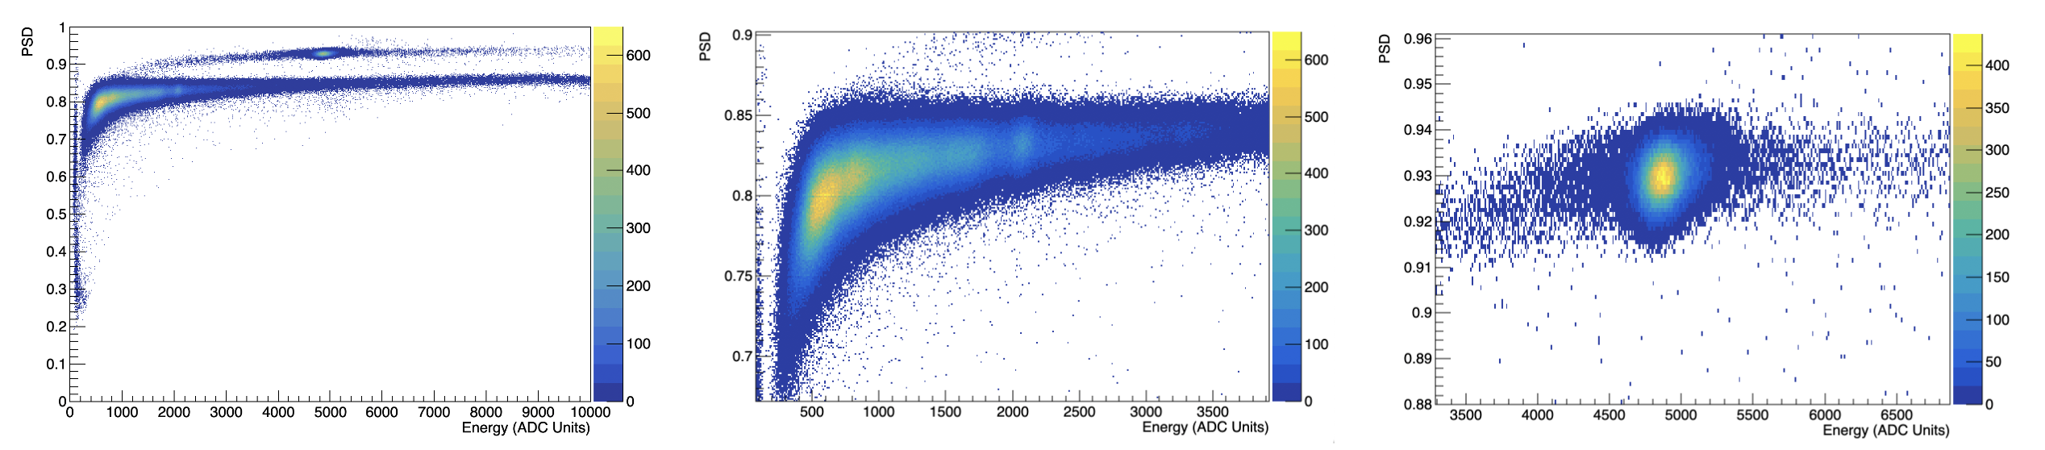
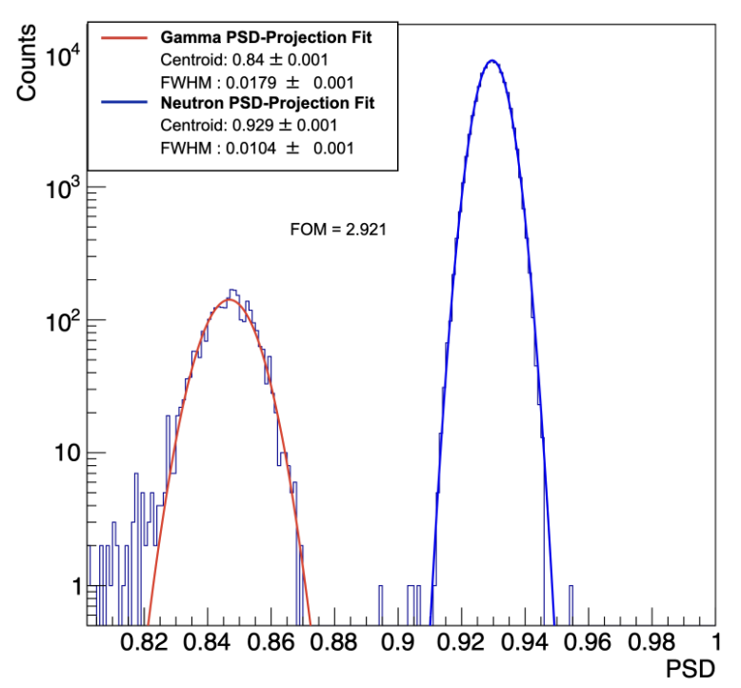
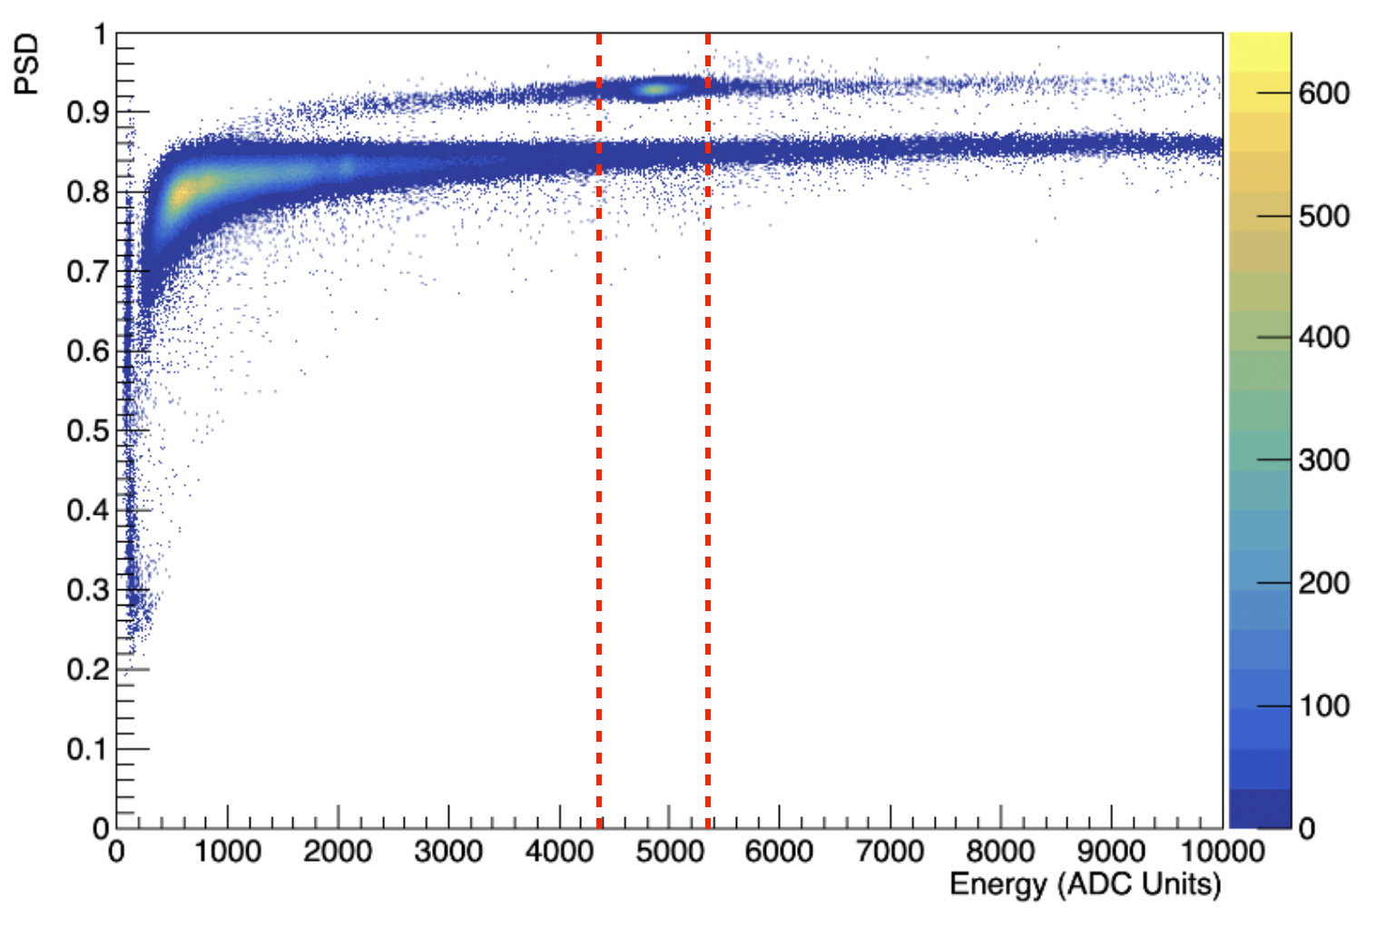
Neutron-gamma discrimination with a CLYC
Optimized Energy
All events
$γ$-rays events
Neutron events
Optimized PSD & Energy
All events
$γ$-rays events
Neutron events

Slide 18






Measurements & Results
6LiPE with a slit (~5 mm thick)
6LiPE with a slit (~5 mm thick) after subtracting the background
6LiPE without a slit (background)

Slide 19
First POC experiment of neutron imaging at ILL

Slide 20



Experimental setup & Measurements
Experimental Set up
Experimental setup location: placed in air along the neutron beam, 2 meters downstream from FIPPS installation. Suppression the thermal neutron background.
Neutron beam: thermal spectrum with a Maxwellian distribution around 25 meV.
CLYC crystal, AiT 4-Channel Readout instrumentation & CAEN DAQ motherboard: same than previous experimental setups.
Fig. A: reduced version of GN-VISION, including only the subsystem responsible for neutron imaging
Fig. B: detail of pinhole collimator.
Fig. C: target centered with the center of the pinhole collimator.
Fig. D: final arrangement. GN-VISION positioned transversally to the beam direction.
A
B
C
D
+X
To place neutrons scattering objects in the thermal neutron beam so that they acts as isotropic sources.

Slide 21






Results
1 cm${}^{3}$ PE cube centered in the hole of the collimator
1 cm${}^{3}$PE cube displaced 2 cm downstream
8 cm${}^{3}$PE cube centered in the hole of the collimator
Beam direction
Beam direction
Beam direction

Slide 22



Neutron source Imaging
+Y
+X
Beam direction
Neutron imaging

Slide 23
Conclusions
Comprehensive Study: The GN-Vision device, designed for dual detection and spatial localization of $γ$-ray and neutron sources, was thoroughly studied. Core components like the CLYC crystal, pinhole collimator, and Pulse Shape Discrimination (PSD) for neutron-gamma discrimination were examined.
Spatial Characterization: A scanning table with mechanical collimation and PET coincidences was used to characterize the CLYC-6 detector's spatial resolution, linearity, and compression for $γ$-rays. GEANT4 simulations helped separate the intrinsic resolution of the detector from experimental setup influences. They showed how spatial and energy resolution affect image quality. Results showed high spatial resolution below 6 mm and adequate linearity .
Imaging Quality: GEANT4 simulations of GN-VISION device were carried to analyze how spatial experimental effects impact on Compton and Neutron imaging. The results showed an imaging broadened source distributions and increased background noise, but source positioning remained accurate.
Neutron-Gamma Discrimination: Effective discrimination was achieved using PSD techniques, with a high Figure of Merit (FOM) of 2.921 indicating good separation between neutron and $γ$-ray events.
Experimental Validation: Initial tests with a ${}^{252}$Cf source demonstrated the system's ability to distinguish between $γ$s and neutron radiation, with clear interaction patterns corresponding to the experimental setup.
Neutron Imaging Proof-of-Concept: At the ILL in France, GN-Vision successfully distinguished between different neutron source positions and sizes, confirming its neutron imaging capability and potential for detailed spatial neutron detection.

Slide 24
THANKS

Slide 25
Supportive Slide

Slide 26
Content
Background for the development of GN-Vision
Motivation
Scintillation Detectors
The i-TED Concept
GN-Vision: Imaging of $γ$-rays and Neutrons
Overview & Core components of GN-Vision
Readout electronics of GN-Vision
GN-Vision: status and goals of this work
Characterization of the spatial resolution of the CLYC
Experimental Setup and Measurements
Geant4 simulations
Results
Impact of the spatial resolution on GN-VISION
Geant4 simulation
Results
First test of the position-sensitive’s response to neutrons
Experimental setup and Measurements
Neutron-gamma discrimination
Results
First POC experiment of neutron imaging at ILL
Experiment at ILL
Measurements and Results

Slide 27



Radiation-Matter Interaction & Scintillation Detectors
$γ$-Rays
Photoelectric Effect
Compton Scattering
Pair Production
Neutron
Elastic Scattering
Inelastic Scattering
Absorption Reactions
Radiation-Matter Interaction
Scintillation Detectors
Monolithic Crystals & Pixelated Crystals
Photosensors: PMTs and SiPMs

Slide 28

GN-Vision: status and goals of this work
Our objectives include:
Spatial Resolution Characterization
Spatial resolution of CLYC monolithic crystal using AiT's readout for $γ$-radiation.
Linearity Study
Linearity of the CLYC crystal of interaction points
Performance Impact on GN-Vision
Characterize how spatial resolution and linearity affect the GN-Vision performance.
Neutron Response and Discrimination
Initial tests of GN-Vision's response to neutron irradiation
Experimental Proof-of-Concept
Experimental proof-of-concept for neutron imaging capability at ILL, France.
Monolithic crystal + SiPM array
=
Spatial Resolution depending
on pixels activated

Slide 29

Compton and PET filtering events
E₂
i-TED-C:
COMPTON
E₁
PET
(25 PET Coincidence lines in total!)
E₁ + E₂ = E_{g}
E₁’ + E₂’ = E_{g}
E_{D} = 511 keV
E_{A} = 511 keV
511 keV
𝛽⁺
511 keV
E’₁
i-TED-A:
E’₂
E_{A}

